Slide 1
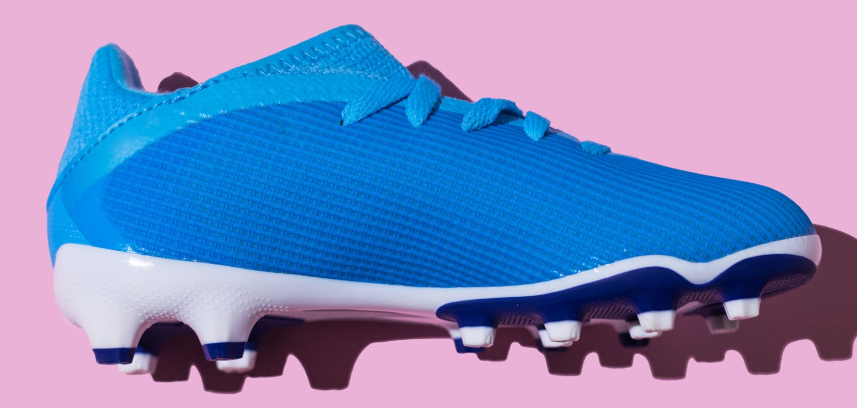

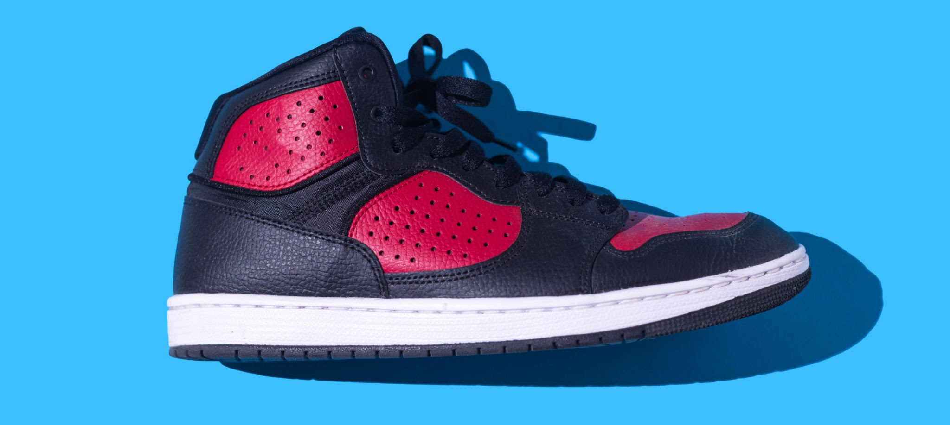
Presenters: Evan Bohler and Charlie Whittleman
Other Members: Jayme Greer and Sophie Miller
Step Smart:
Injury Preventive Insole

Slide 2
Overall Problem
Athletes experience joint pain and injury from improper foot placement
Many athletes suffer injuries due to improper foot posture, leading to inflammation, pain, and setbacks.
Some injuries may force athletes to pause or even end their training or careers.
According to the American Academy of Orthopedic Surgeons, 25%
of sports injuries are foot and ankle related.
We aim to design a solution that corrects poor placement and prevents injuries before they happen.

Slide 3
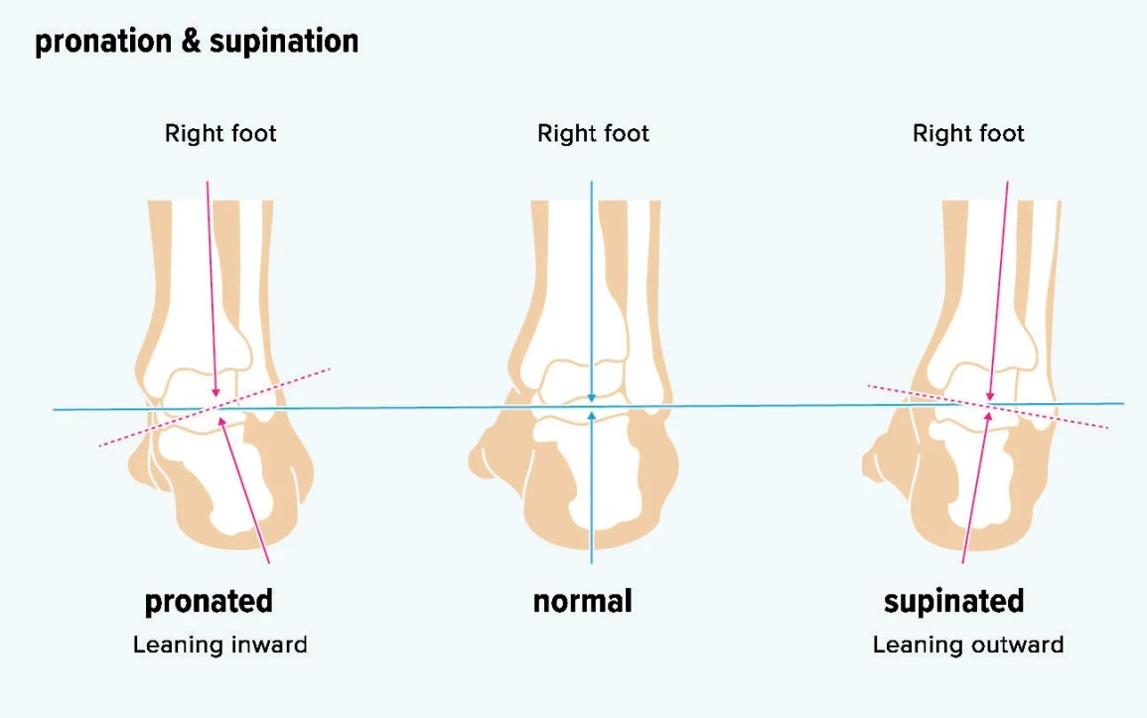
Foot Posture
Overpronation occurs when the foot rolls inward excessively, while oversupination occurs when the foot rolls outward
Improper foot alignment places unnecessary stress on the body, leading to inflammation, pain, and potentially permanent injuries
Current solutions are static and reactive, delaying problem detection
What if we could track weight distribution and foot posture in real-time?
https://www.healthline.com/health/bone-health/whats-the-difference-between-supination-and-pronation#the-foot

Slide 4

Design Research

Slide 5
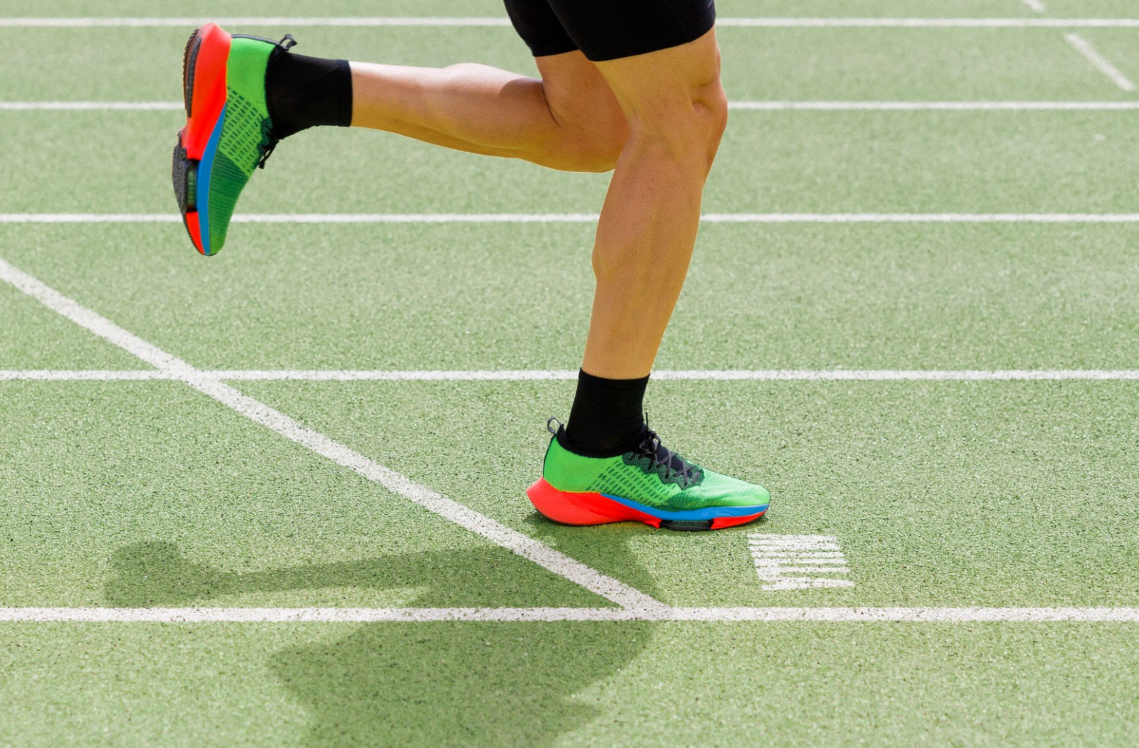
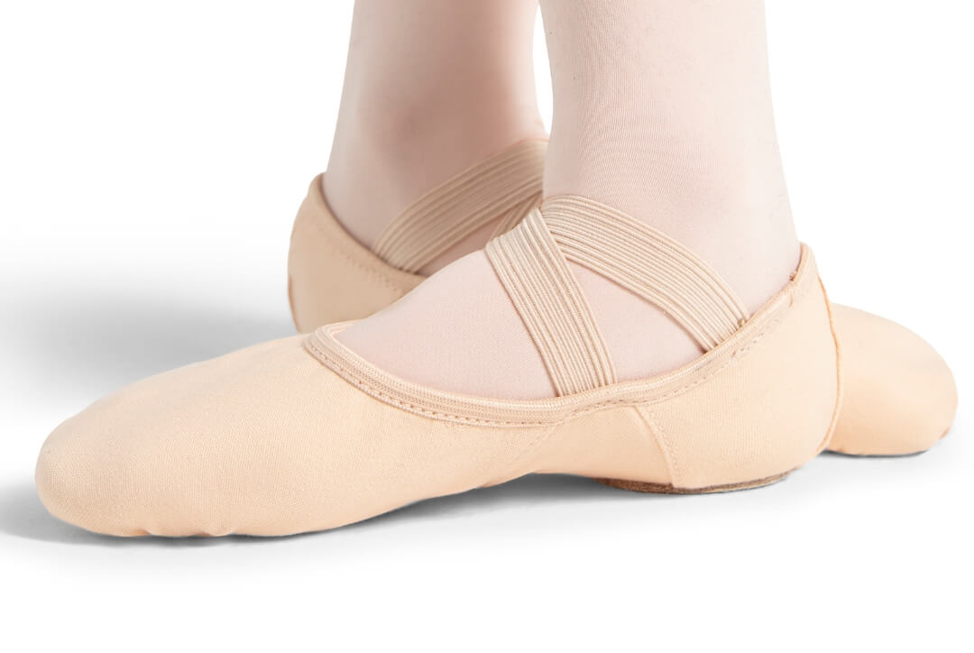
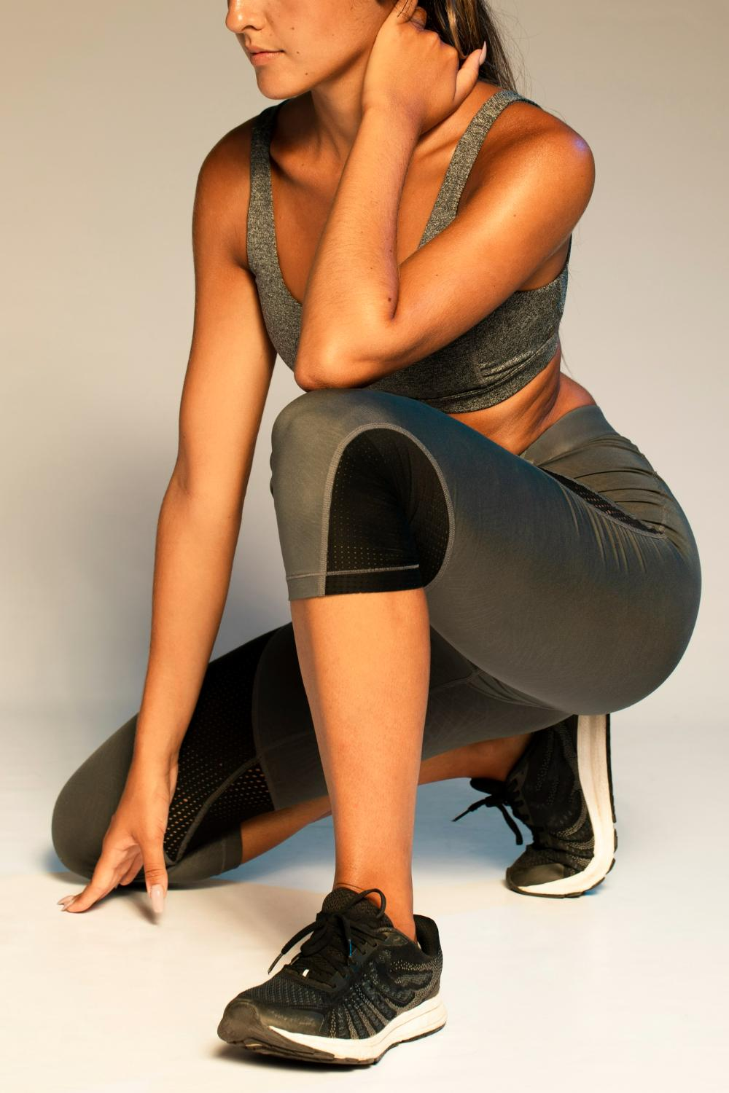
Methods
Participants
Key Findings
Participant 1:
50 year old runner and cyclist of 20+ years
Participant 2:
Dance instructor in her 30s with 25+ years of experience in dance
Participant 3:
Previous SIUE D1 dancer in her 20s with 8+ years of experience
The main needs for our device are adaptability, durability, and compatibility. The product must be versatile for different exercises, durable for high-impact use, and compatible with existing fitness apps for a seamless experience.
We conducted interviews with athletes across different disciplines.
Given the differences in footwear and movements across sports, we explored how our design could be adaptable and seamlessly integrated into their routines and equipment.

Slide 6

Considered Tasks

Slide 7

Tasks
The
Task 1
Task 2
Use an app to see health and fitness data visuals
Send health and fitness data to doctors and coaches
Task 3
Task 4
Comfortably wear tracking tools for long lengths of time
Versatile for multiple activities
Task 5
Task 6
Know how one’s feet are positioned during activities
Wear tracking tools in all weather conditions

Slide 8

Sketches

Slide 9
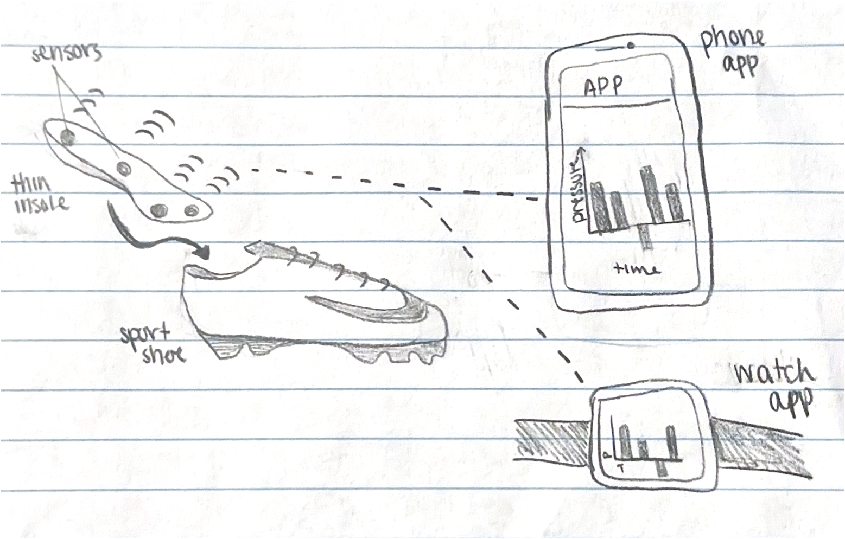
Sketch 1
Full Insole Pressure Sensor
Full-length shoe insole insert with built-in pressure sensors placed at the ball of the foot, heel, arch, and the base of the pinky toe.
Thin sensors ensure comfort while accurately tracking pressure distribution.
Data is sent to an app on the user’s phone or smartwatch, and displayed through graphs and charts.
Fits into various shoe types while maintaining durability and waterproofing.

Slide 10
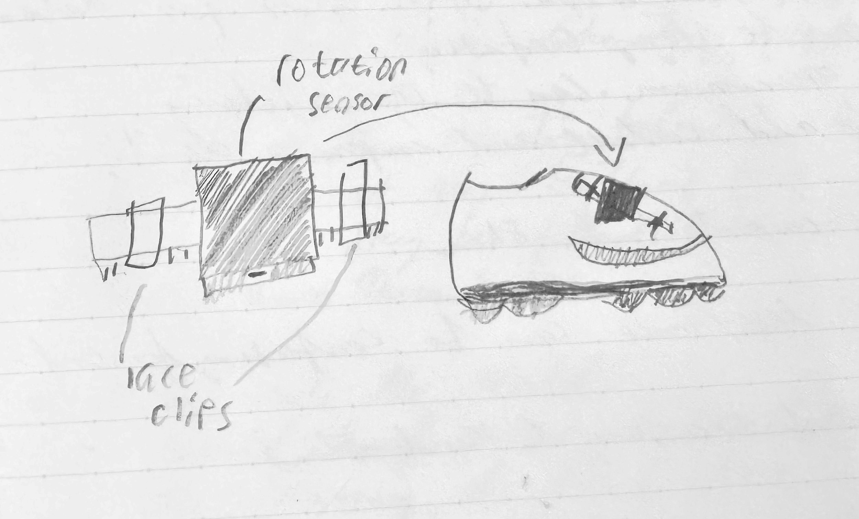
Sketch 2
Lace Clip-On Sensor
Clips onto shoelaces and tracks rotation.
Designed to be as non-invasive as possible in order to prevent users from changing their movement patterns to account for the feeling of something beneath their foot with the insole design
Light, durable, waterproof, and a great option for footwear that doesn’t support custom insoles

Slide 11
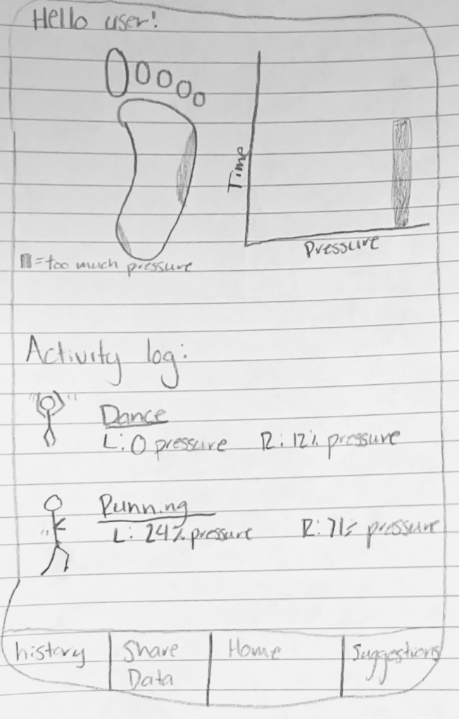
Sketch 3
Mobile Foot Fitness App
App syncs to the sensor and visualizes data in a way that is easy to understand like graphs and charts.
Compatible with all types of phones as well as smart watches for user convenience.
Collected data will be sharable with trusted professionals to ensure the user gets the proper feedback to help make the necessary corrections.

Slide 12

Storyboards

Slide 13
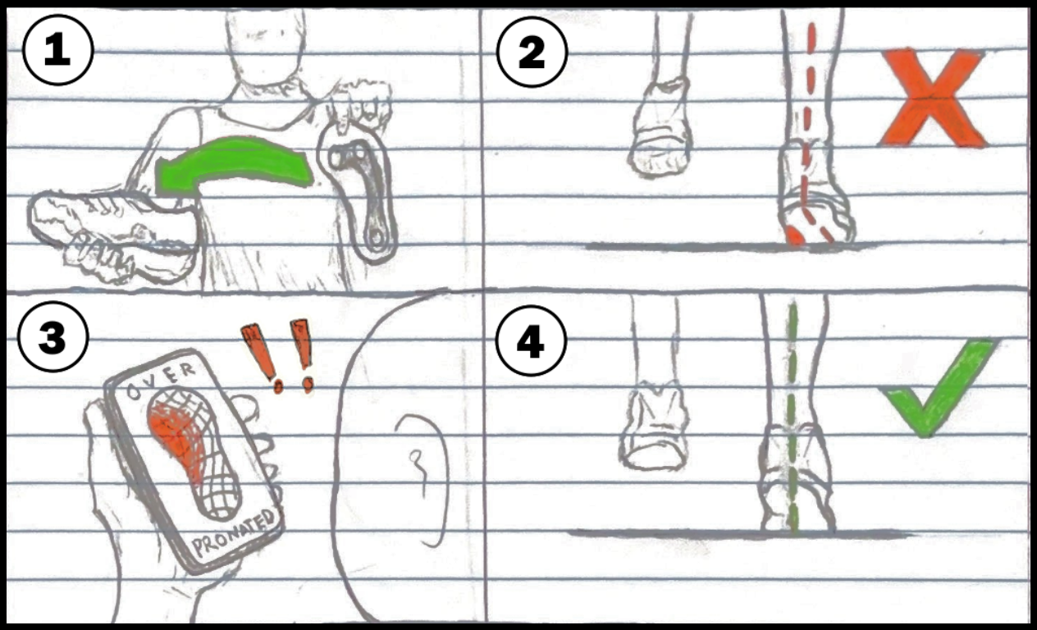
Storyboard 1
Task: Knowing how one’s feet are positioned during activities
The insole design proved to be ideal for our most important task and the desires of our interviewees.
It provides the best surface coverage for posture tracking while still being versatile for a wide range of activities.

Slide 14
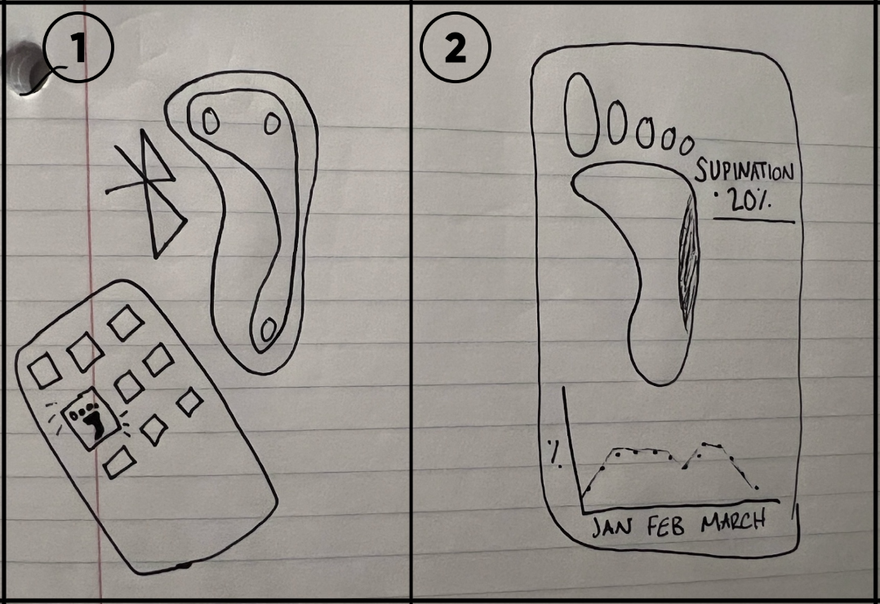
Storyboard 2
Task: Use an app to see health and fitness data visuals
Without an interface for the tracking data, our goals of accessibility and real-time feedback are not met.
An app translates tracking data into clear insight and digestible information. It helps users and professionals in visualizing and understanding foot posture issues.

Slide 15

Thank you

Slide 16
Contributions:
Evan Bohler: 40% – helped organize presentation, presented
Charlie Whittleman: 35% – presented
Jayme Greer: 25% – helped organize presentation, will present next time
Sophia Miller: 0% – will present next time

